Slide 1
Team 12
NETS (nothing else to sync)
Dang Thi Thu Giang
Hoang Nguyen Nhat Tao
Nguyen Hoang Hai
Nguyen Thi Yen Duong
Vu An Hoa

Slide 2
Logic Overview
Two main classes:
Detector: detecting differences of two folders
Reconciler: reconcile differences found by Detector

Slide 3
Logic Overview
Metadata of a FILE is saved after synchronization for next-sync comparison.
Status of a FILE:
Not-exist
New
Deleted
No-change
Updated
Notes:
Status of a file depends on the whether it exists and whether its metadata exists.
Not-exist: the file and its metadata both do not exist
New: the file exists, its metadata does not exist
Deleted: the file does not exist but its metadata exists
No-change: the file and its metadata both exist. The file’s content is not changed since the last synchronization.
Updated: the file and its metadata both exist. The file’s content is changed since the last synchronization.

Slide 4
Logic Overview
Two files are compared against their metadata to determine if they are updated
METADATA
FILE
FILE
SOURCE
DESTINATION

Slide 5
Detector
FindDifferences(source, destination)
foreach file in source
partnerFile = GetPartner(file, source, destination)
fileStatus = FindStatus(file, source)
partnerStatus = FindStatus(partnerFile, destination)
if it is folder
FindDifferences(file, partnerFile)
if (partnerStatus is DELETED) AddToCleanUpList(file)
else
if (fileStatus is NO-CHANGE and partnerStatus is NO-CHANGE) continue
AddToDifferenceList(file, fileStatus, partnerFile, partnerStatus)
foreach file in destination but not in source
partnerFile = GetPartner(file, destination, source)
fileStatus = FindStatus(file, destination)
partnerStatus = FindStatus(partnerFile, source)
if it is folder FindDifferences(partnerFile, file) if (partnerStatus is DELETED) AddToCleanUpList(file)
else AddToDifferenceList(partnerFile, partnerStatus, file, fileStatus)

Slide 6
Reconciler
SyncTwoWay(differenceList, cleanUpList)
foreach pair of status in differenceList
case NEW and NOT-EXIST:
Copy
case NEW and NEW:
Choose latest-modified file
Copy and overwrite
case UPDATED and NO-CHANGE:
Copy and overwrite
case DELETED and NO-CHANGE:
Delete
case UPDATED and UPDATED:
Choose latest-modified file
Copy and overwrite
case UPDATED and DELETED:
Copy
CleanUpEmptyFolder(cleanUpList)

Slide 7
Why this algorithm?
Simple
Easy to implement
Easy to understand
Fast
Extensible to batch processing
Detector and Reconciler do different tasks → changing one of them does not affect the other → easy refactoring and optimizing

Slide 8
Another choice: FileSystemWatcher
Much more difficult to implement
Watch for and record changes in folders for future sync
High CPU usage, more IO error prone in recording → can lead to wrong reconciliation
Slow down the computer because of background watching

Slide 9
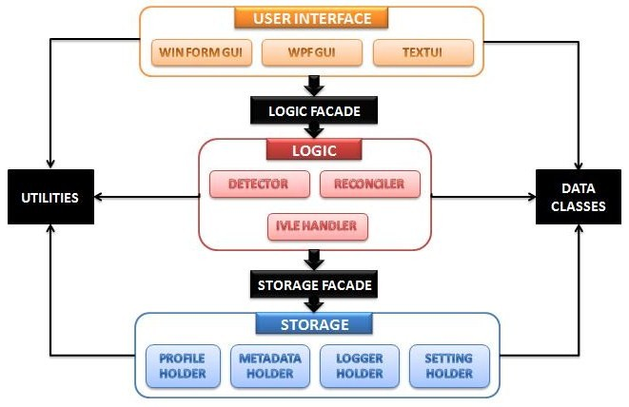
Architecture

